Slide 1
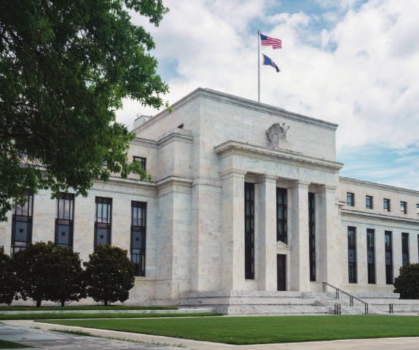
Chapter 18: Monetary Policy
Wayne Geerling
University of Texas

Slide 2
Big Questions
What is the effect of monetary policy in the short run?
Why doesn’t monetary policy always work?

Slide 3
The Federal Reserve System
The Federal Reserve System (the Fed) is the central bank of the United States.
A central bank is the public authority that regulates a nation’s depository institutions and controls the quantity of money.

Slide 4
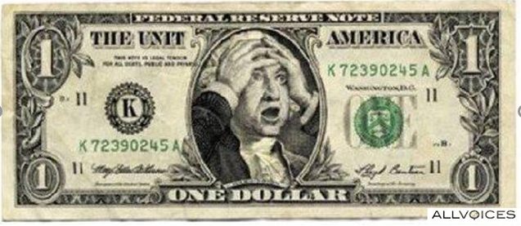
Main Roles of the Fed
The Federal Reserve Act of 1913 did not incorporate any macroeconomic goals for monetary policy, but instead required the Fed to “provide an elastic currency.” The idea was that the Fed would help prevent financial crises and banking panics.

Slide 5

Leverage
During the housing boom, many people purchased houses with down payments of 5 percent or less. In this sense, borrowers were highly leveraged , which means that their investment in their house was made mostly with borrowed money.
RETURN ON YOUR INVESTMENT FROM . . .
DOWN PAYMENT | A 10 PERCENT INCREASE IN THE PRICE OF YOUR HOUSE | A 10 PERCENT DECREASE IN THE PRICE OF YOUR HOUSE
100% | 10% | -10%
20 | 50 | -50
10 | 100 | -100
5 | 200 | -200
Making a very small down payment on a home mortgage leaves a buyer vulnerable to falling house prices.

Slide 6

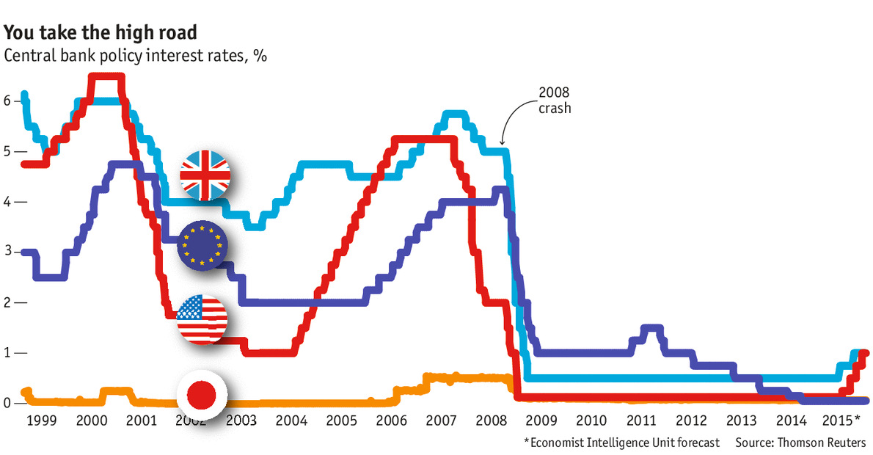
FED Policy Failures after 9/11 led to…

Slide 7
Monetary Policy
The Federal Reserve changes the money supply through open market operations.
Open market operations involve the purchase or sale of bonds; normally, these are short-term bonds.
The price in the loanable funds market is the interest rate.
Lower interest rates increase the quantity of investment demand.
Investment is one component of AD, so changes in investment indicate corresponding changes in AD.

Slide 8
Changes in interest rates affect three components of AD:
Consumption
Investment
Net eXports

Slide 9
Expansionary Monetary Policy
When a central bank acts to increase the money supply in an effort to stimulate the economy.
Typically expands the money supply through open market purchases.
When the money supply increases, bank reserves increase.
Interest rates then fall.
With lower interest rates, firms decide to invest.
Aggregate demand shifts right.

Slide 10
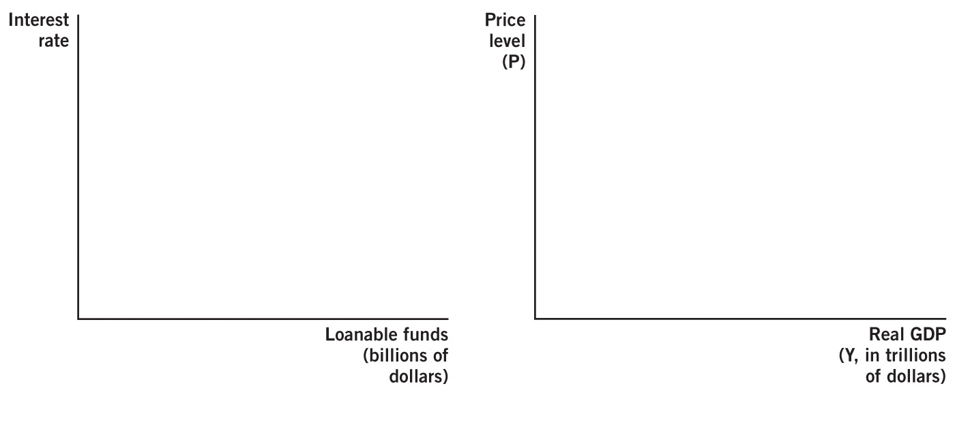
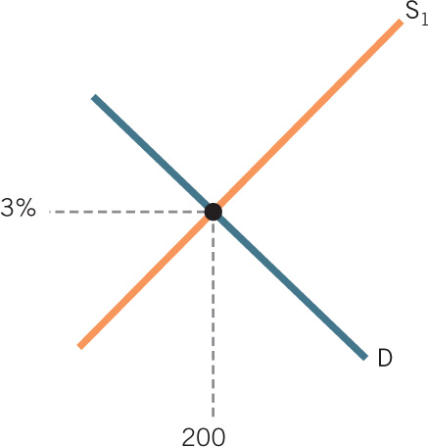
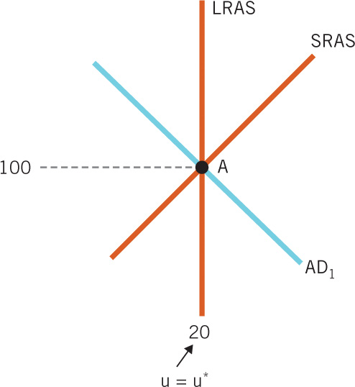
Expansionary Monetary Policy in the Short Run

Slide 11

Real vs. Nominal Effects
If the Fed can increase real employment and output by increasing the money supply, why don’t we just keep printing money?

Slide 12
Real vs. Nominal Effects
Monetary policy can have real effects such as increasing output & reducing unemployment.
However, new money devalues the entire money supply, because prices rise.
As prices adjust in the long run, the effects of the new money wear off.
In the long run, the real effects of monetary policy dissipate completely.
Only change in the long run is higher prices.

Slide 13
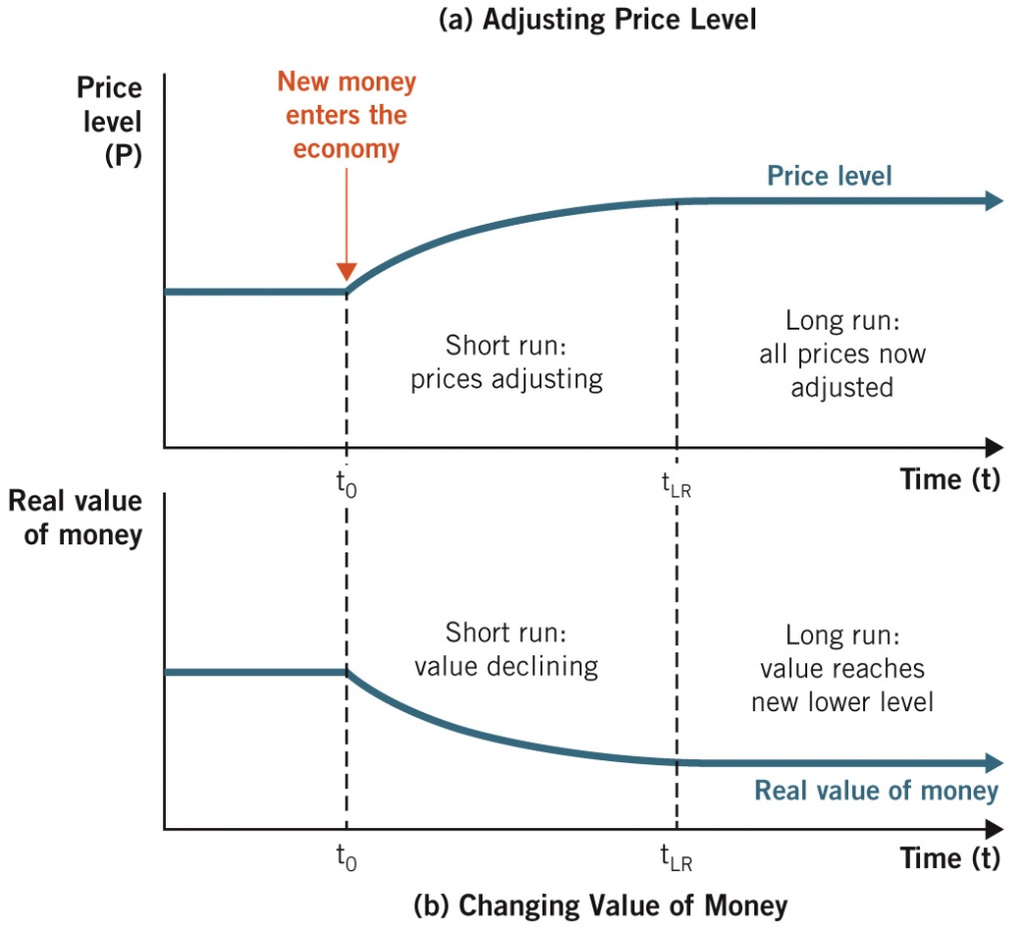
Real Value of Money as Prices Adjust

Slide 14
Unexpected Inflation Hurts Some People
If inflation is higher than expected, it hurts:
1. Input suppliers that have sticky prices.
2. Workers who signed wage contracts.
3. Resource suppliers who are contracted to sell goods at a given price are hurt by tomorrow’s unexpected inflation.

Slide 15
Unexpected Inflation Hurts Some People
If inflation is lower than expected, it hurts:
1. Demanders who signed a fixed-price contract.
2. Employers who create wage contracts.
3. Resource purchasers who signed long-term contracts to buy goods at certain prices.

Slide 16
Contractionary Monetary Policy
When a central bank takes action that reduces the money supply in the economy.
Often done during times of rapid expansion in order to curb potential inflation
The central bank reduces the money supply via open market sales.
Lower supply of loanable funds increases interest rates.
With higher interest rates, investment falls, shifting AD to the left.

Slide 17
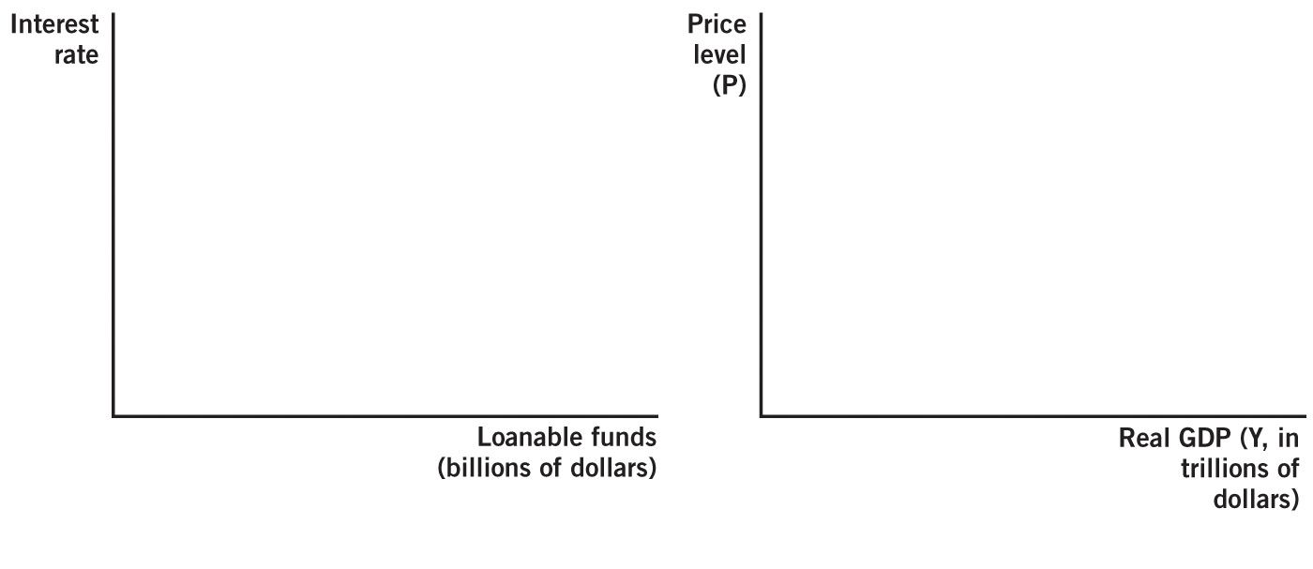
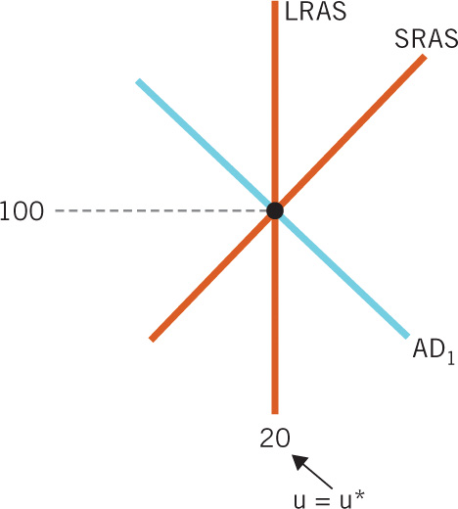
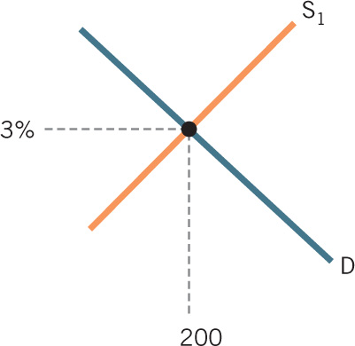
Contractionary Monetary Policy in the Short Run

Slide 18
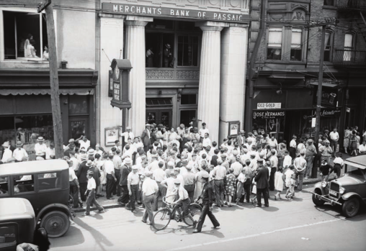
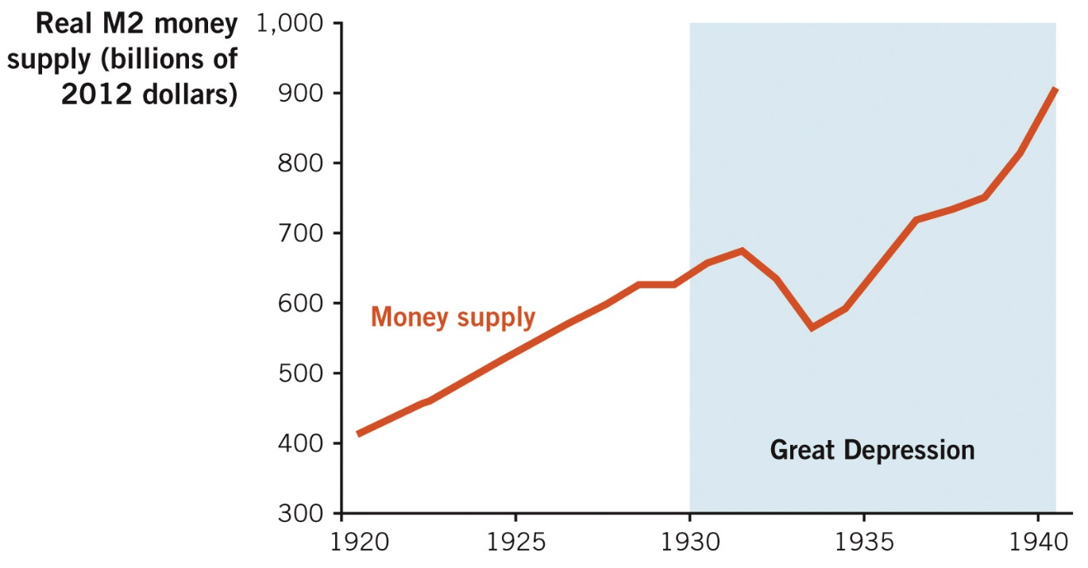
U.S. Money Supply Before & During the Great Depression
The huge decline in money supply between 1931-33 was a major contributor to the Great Depression.

Slide 19
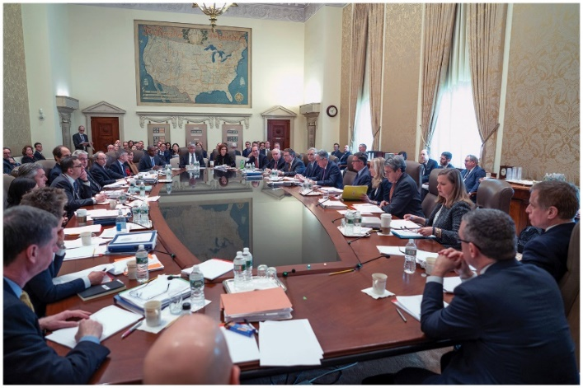
Shortcomings of Monetary Policy
Monetary policy is limited in what it can accomplish.
Its limitations include:
Diminished effects in the long run
Effects being reduced by people’s expectations
Less effective if downturns are caused by AS, rather than AD

Slide 20
Long-Run Effects of Monetary Policy
Monetary neutrality: The idea that the money supply does not affect real economic variables.
Because eventually all prices adjust, in the long run, monetary policy does not affect real GDP or unemployment.
Because monetary policy does not affect the long run, many economists suggest that the Fed should instead focus on short-run issues such as smoothing out the business cycle.

Slide 21
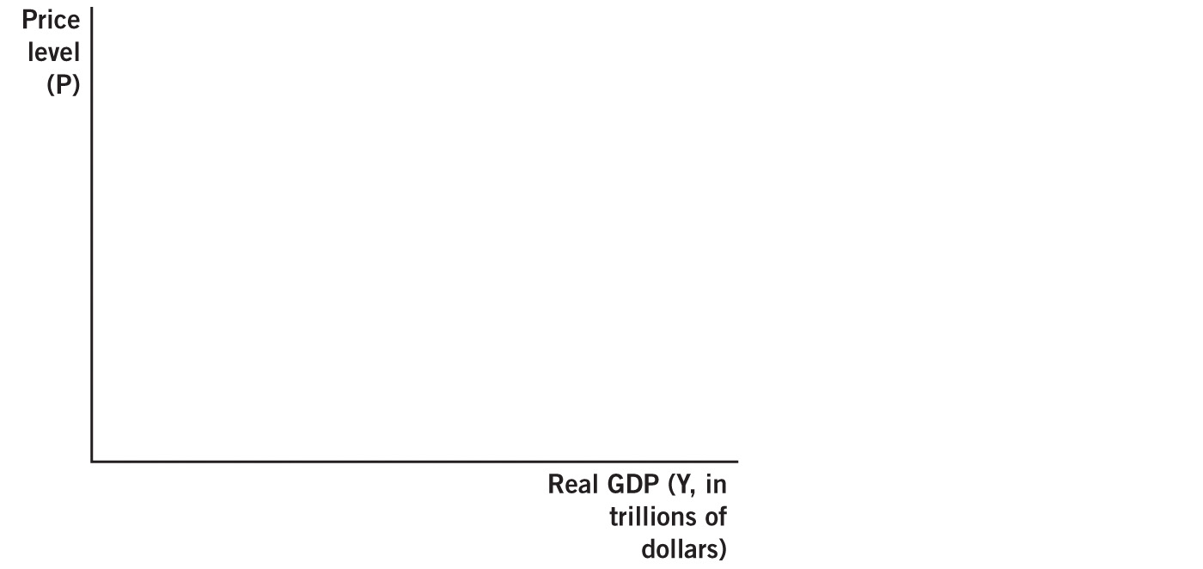
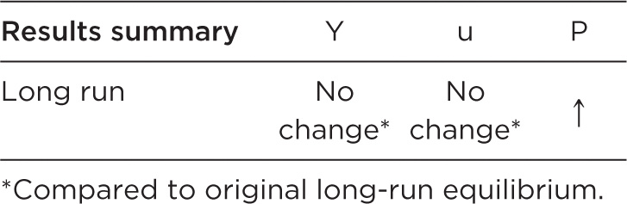


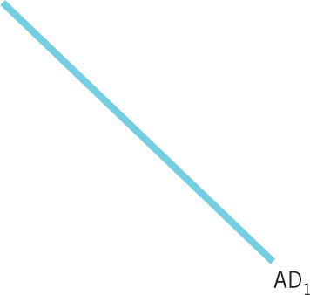



Expansionary Monetary Policy in the Long Run

Slide 22
Adjustments in Expectations
Unexpected inflation harms people.
So, people have an incentive to adjust & prepare for inflation.
Monetary policy has real effects only when some prices are sticky (when inflation is unexpected).
But if inflation is expected, prices are not sticky; prices rapidly adjusting because people plan on the inflation.

Slide 23
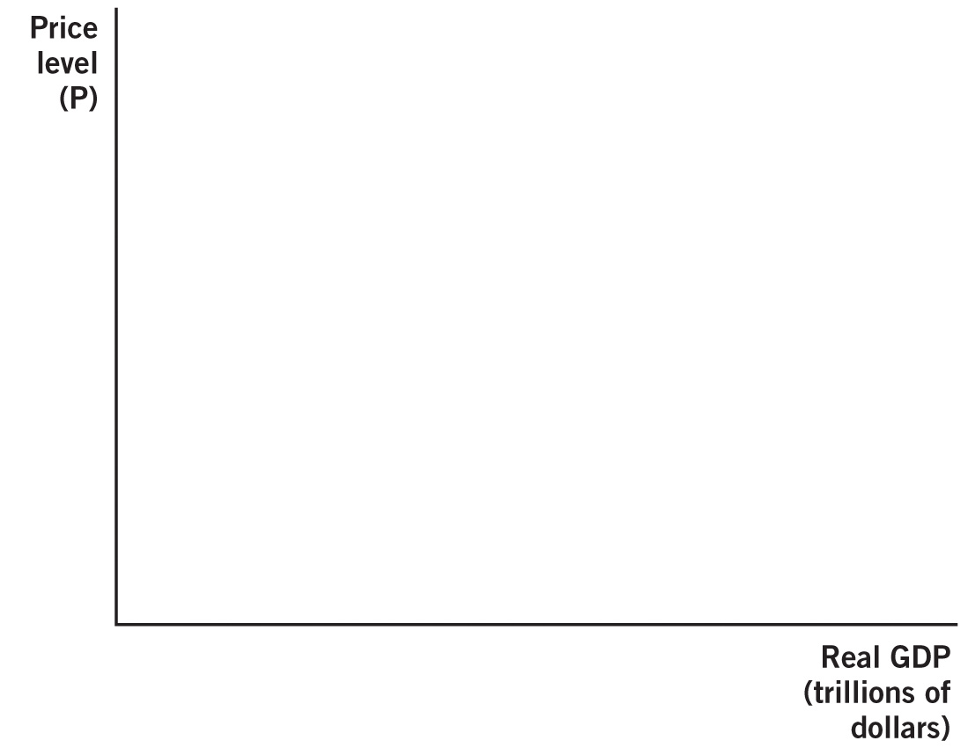

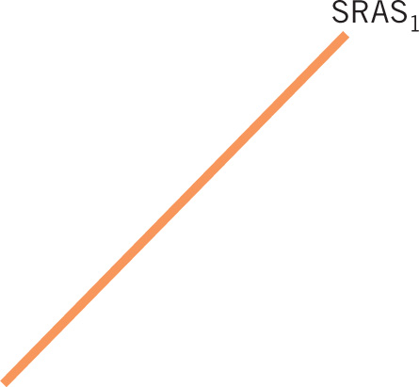
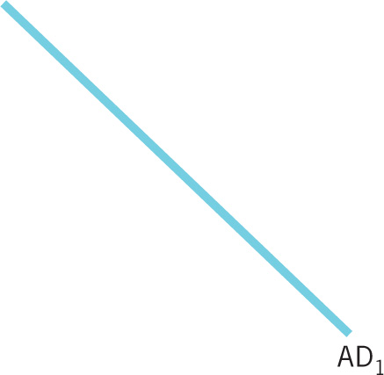

Completely Expected Monetary Policy

Slide 24
Aggregate Supply Shifts
When recessions are caused by declines in AD, monetary policy can help restore AD to its initial level.
However, not all recessions are caused by AD.
Great Recession:
LRAS and AD decreased in this recession.
Monetary policy issues:
Monetary policy wears off in the long run:
Cannot shift LRAS.
Limited ability to return to original output level.

Slide 25
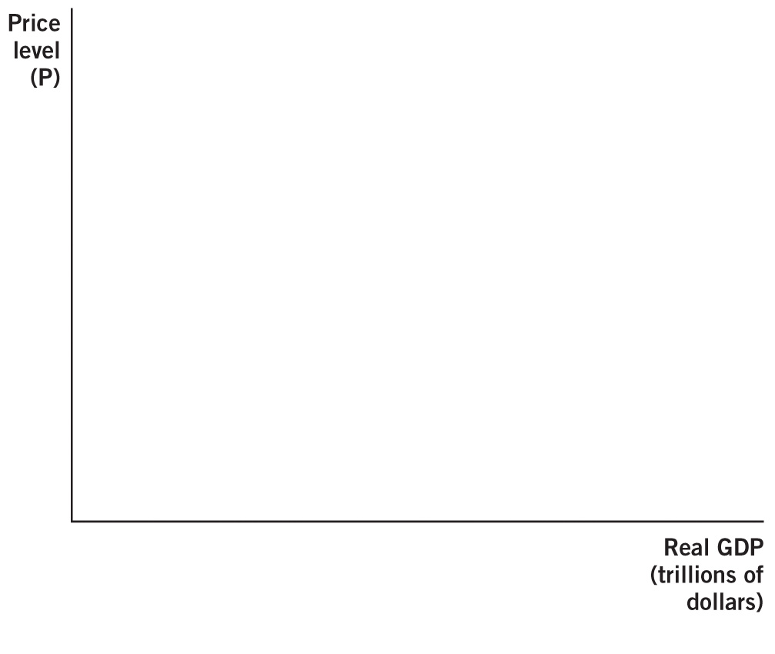
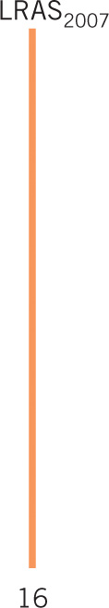
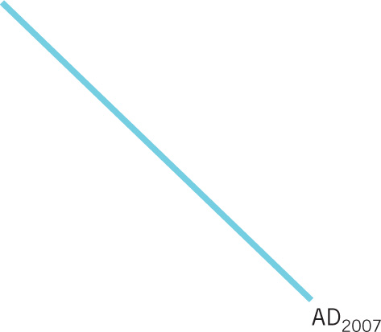
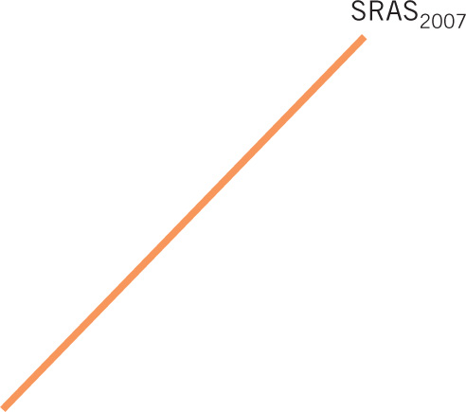

Aggregate Supply–Induced Recession

